Slide 1
USERSPACE I/O
Reporter:
R98922086 張凱富

Slide 2
Introduction
For many types of devices, creating a Linux kernel driver is overkill.
Most Requirements :
handle an interrupt
access to the memory space of the device
no need for other resources in kernel
One such class of devices :
industrial I/O cards

Slide 3
Introducion
Userspace I/O systems are designed
only a very small kernel module needed
main part running in user space
Advantages :
Ease of development
Stability
Reliability
Maintainability

Slide 4
Introduction
UIO is not an universal driver interface.
Devices well handled by kernel subsystems are no candidates.
Like networking or serial or USB
Requirements for UIO
The device memory can be mapped.
usually generates interrupts
fit into no standard kernel subsystems.

Slide 5
Introduction
Linux kernel 2.6.24 permit userspace drivers
Industry card
Linux kernel tends to be monolithic
Short response time
Mode protection

Slide 6
Difficulties to Be Solved
Direct interrupt to userspace
User processes access hardware
Support DMA
Efficient communication between User/Kernel space

Slide 7
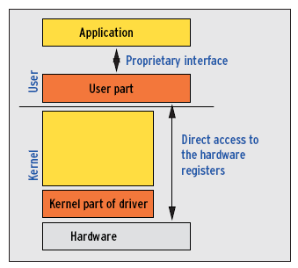
Linux Userspace Driver Model

Slide 8
How It Works
Map hardware memory to drivers’ address space
Kernel part includes interrupt service routines
It is notified when interrupt is thrown by blocking or reading from /dev/uio0
Then waiting processes wake up
Driver parts exchange data via maped registers (addresses)

Slide 9
How It Works
Driver model just specifies
How resources are mapped
How interrupts are handled
Userspace drivers determine how to access devices

Slide 10
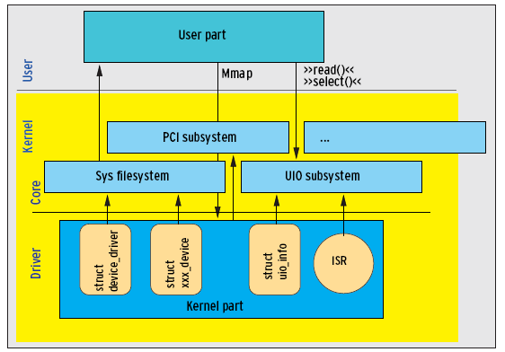
The Kernel Part Juggles Three Objects

Slide 11
Kernel Part
struct uio_info kpart_info = {
.name = "kpart",
.version = "0.1",
.irq = UIO_IRQ_NONE,
};
static int drv_kpart_probe(struct device *dev);
static int drv_kpart_remove(struct device *dev);
static struct device_driver uio_dummy_driver = {
.name = "kpart",
.bus = &platform_bus_type,
.probe = drv_kpart_probe,
.remove = drv_kpart_remove,
};

Slide 12
Kernel Part
static int drv_kpart_probe(struct device *dev) {
kpart_info.mem[0].addr =
(unsigned long)kmalloc(2,GFP_KERNEL);
if( kpart_info.mem[0].addr==0 )
return -ENOMEM;
kpart_info.mem[0].memtype =UIO_MEM_LOGICAL;
kpart_info.mem[0].size =512;
if( uio_register_device(dev,&kpart_info) )
return -ENODEV;
return 0;
}

Slide 13
Kernel Part
static int drv_kpart_remove(struct device *dev){
uio_unregister_device(&kpart_info);
return 0;
}
static struct platform_device *uio_dummy_device;
static int __init uio_kpart_init(void)
{
uio_dummy_device = platform_device_register_simple("kpart", -1,NULL, 0);
return driver_register(&uio_dummy_driver);
}

Slide 14
Kernel Part
static void __exit uio_kpart_exit(void)
{
platform_device_unregister(uio_dummy_device);
driver_unregister(&uio_dummy_driver);
}
module_init( uio_kpart_init );
module_exit( uio_kpart_exit );
MODULE_LICENSE("GPL");

Slide 15
Registration
In uio_register_device(), UIO subsystem check if the device model contains uio device class.
If not, it creates the class.
It ensures a major number to module and reserves minor number to the driver.
udev creates device file /dev/uio# (#starting from 0)

Slide 16
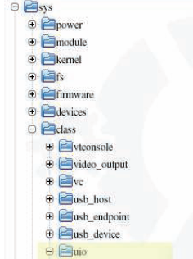
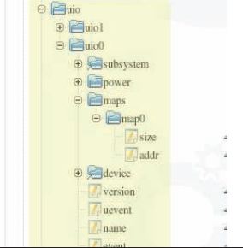
Registration
To find out the hardware represented by device files, we can look up the pseudo-files in the sys file system

Slide 17
User Part
The user part finds the address information stored by the kernel part in the relevant directory.
The user part then calls mmap() to bind the addresses into its own address space.

Slide 18
User Part
#define UIO_DEV "/dev/uio0"
#define UIO_ADDR "/sys/class/uio/uio0/maps/map0/addr“
#define UIO_SIZE "/sys/class/uio/uio0/maps/map0/size"
static char uio_addr_buf[16], uio_size_buf[16];
int main( int argc, char **argv ) {
int uio_fd, addr_fd, size_fd;
int uio_size;
void *uio_addr, *access_address;
addr_fd = open( UIO_ADDR, O_RDONLY );
size_fd = open( UIO_SIZE, O_RDONLY );
uio_fd = open( UIO_DEV, O_RDONLY);

Slide 19
User Part
read( addr_fd, uio_addr_buf, sizeof(uio_addr_buf) );
read( size_fd, uio_size_buf, sizeof(uio_size_buf) );
uio_addr = (void *)strtoul( uio_addr_buf, NULL, 0 );
uio_size = (int)strtol( uio_size_buf, NULL, 0 );
access_address =
mmap(NULL, uio_size, PROT_READ, MAP_SHARED, uio_fd, 0);
printf("The HW address %p (length %d) can be accessed over
logical addrss %p\n", uio_addr, uio_size, access_address);
// Access to the hardware registers can occur from here on ... return 0;
}

Slide 20
User Part
A routine that needs to be notified when interrupts occur calls select() or read() in non-blocking mode.
read() returns the number of events (interrupts) as a 4-byte value.

Slide 21
Pros and Cons
Advantages:
• Version change: The user only needs to rebuild the kernel part after making any required modifications.
• Stability: Protects the kernel against buggy drivers.
• Floating point is available.
• Efficient, because processes do not need to be swapped.
• License: The user part of the source code does not need to be published (although this is a controversial subject in the context of the GPL).

Slide 22
Pros and Cons
Disadvantages:
• Kernel know-how is required for standard drivers, the sys file system, IRQ, and PCI.
• Timing is less precise than in kernel space.
• Response to interrupts: Response times are longer than in kernel space (process change).
• Functionality is severely restricted in userland; for example, DMA is not available.
• API: The application can’t use a defined interface to access the device.
• Restricted security is sometimes difficult to achieve

